Slide 1
BUNDELKHAND UNIVERSITY, JHANSI Department of Mathematical Science and Computer Applications Resort Management System Software Requirement Specification Web Technology Project Date of Submission – -03-2022 Submitted to: Submitted by: Dr. Sonam Seth Nitesh Sahu MCA – III sem Roll N0. 201345098032

Slide 2
objectives
Universal standard
Large customer reach, Sell More
Interactive platform, Mobile Responsive
Easy to use the checkout
Reporting tool
Identify The Right Target Audience

Slide 3
Sub-system / Modules
Checkout Shipping Payment Customer Accounts Catalog Management Catalog Browsing
Product Browsing Analytics and Reporting Business Reports Order Management Site Management Search Engine Optimization

Slide 4


User Classes and Characteristics
Admin Customer

Slide 5
ADMIN

Slide 6
CUSTOMER

Slide 7
Technology used IN THIS PROJECT
Front-End Technologies
Bootstrap5 (CSS Framework)
Hypertext Mark-up Language (HTML)
Cascading Style Sheets (CSS)
JavaScript
Ajax
Server Side Scripting Technologies
Python –
Django – Web Development Framework
Back-End Technologies
SQLite - open-source relational database management system (RDBMS).

Slide 8
Functional Requirements
User Sign-Up
User Log-In
User Log-out
Forgot Password
Change Password

Slide 9
Functional Requirements - Admin

Slide 10
Functional Requirements - customer

Slide 11

High Level Architecture
View
Reports
Insert
Users Details
Users Details
Update
Owner
Delete
Users Details
Add
Guest Details
Guest Details
Update
Guest Details
Delete
Search
Rooms
Receptionist
Reservations
Make
Issue
Bill

Slide 12
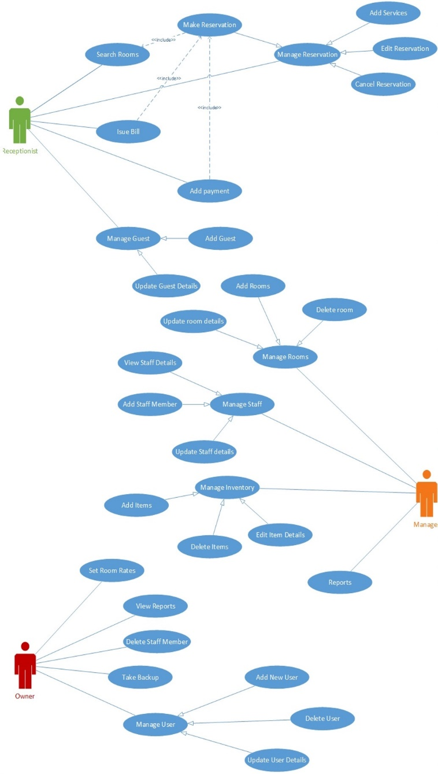
Use Case Diagram

Slide 13
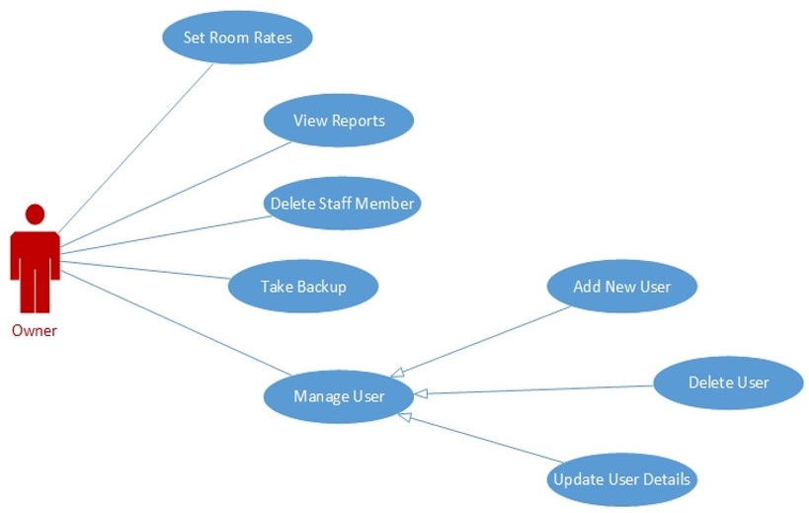
Use Case Diagram

Slide 14
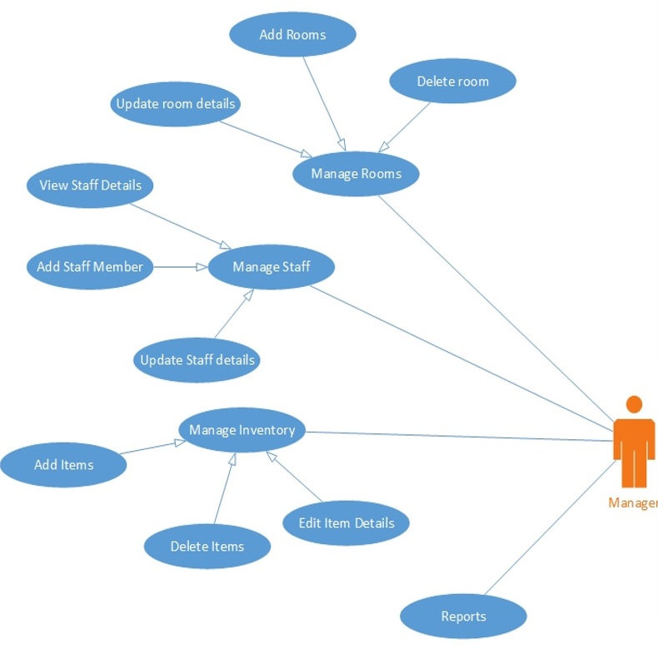
Use Case Diagram

Slide 15
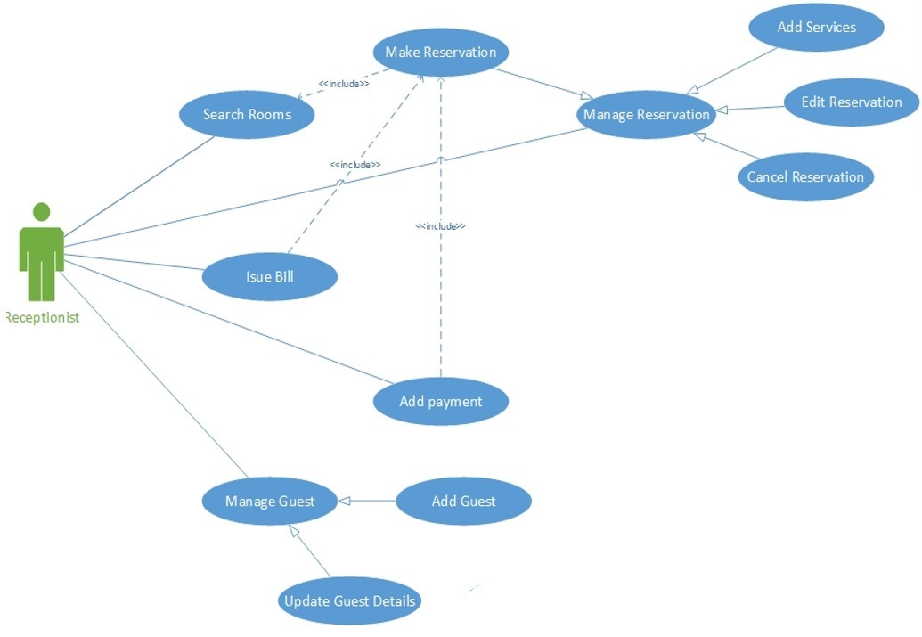
Use Case Diagram

Slide 16
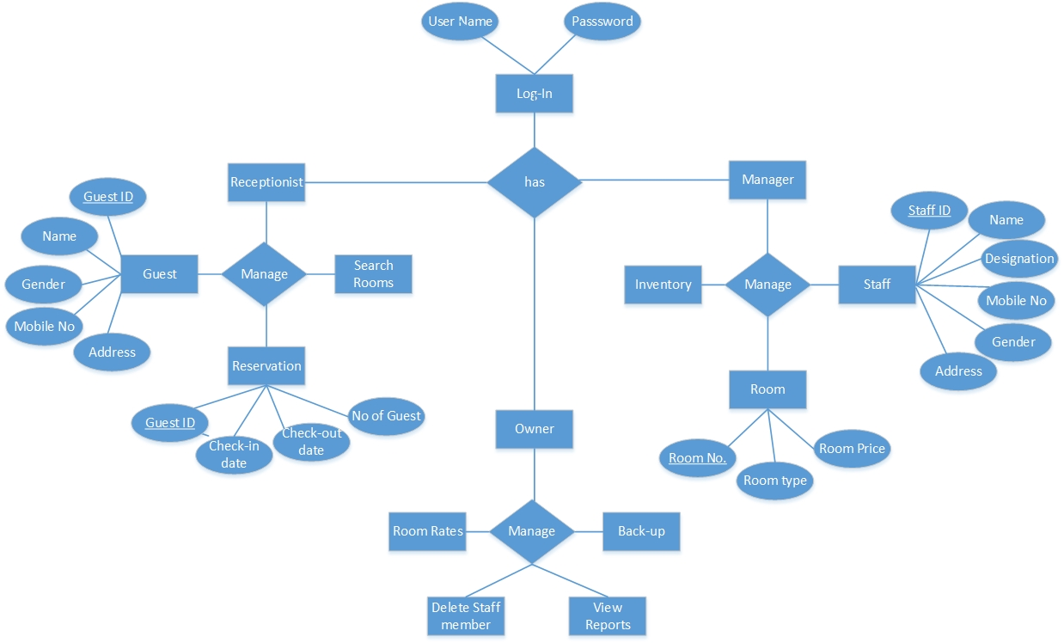
ER-Diagram

Slide 17
Nonfunctional Requirements
Performance Requirements
Performance requirements define acceptable response times for system functionality.
the load time for user interface screens shall take no longer than two seconds. It makes fast access to system functions.
The log in information shall be verified within five seconds causes’ efficiency of the system.
Returning query results within five seconds makes search function more accurate.

Slide 18
Nonfunctional Requirements
Security Requirements
There are several user levels in Resort management system, Access to the various subsystems will be protected by a user log in screen that requires a user name and password. This gives different views and accessible functions of user levels through the system.
Safety Requirements
Maintaining backups ensure the system database security. System can be restoring in any case of emergency.

Slide 19
Software Quality Attributes
Availability: - 24/4 (365 days)
Correctness: - satisfies specifications and fulfills user’s objectives
Efficiency: - In terms of resources and time
Flexibility: - Ability to add new features conveniently.
Integrity: - avoids the data losses and data redundancy.
Portability: - Platform Independent.
Usability: - User-friendly.

Slide 20
.
Thank-You

Slide 21
desciption

